Slide 1
Coaching Evaluations
Ken Stonebraker
Athletic Director
Salina South High School
Ken.Stonebraker@usd305.com

Slide 2
Philosophy
Communication – My goal is to have open dialogue with my coaches during the evaluation process
Praise – Coaches need to hear from you when they do something good. Not always wins and losses
Growth – It is a good idea to pick an area of growth for that season or the following season to focus on
Improvement – If there are areas that need to be improved then it must be addressed in the evaluation
Better coaches – In the end we want better coaches

Slide 3
Head Coaches Council
We meet 3 to 4 times a year to go over various issues that we face in coaching. We meet at 7 a.m. and I provide the donuts
Use this time to have some of your veteran coaches present something that they do. It is an opportunity for our coaches to learn from each other.
Also an opportunity to just get together and talk about bigger issues that impact the entire athletic department – summer schedules, etc.

Slide 4
District Requirements
Must evaluate head coaches once every two years
We have a district form that we use and are required to submit to our HR department
Head coaches are required to evaluate assistant coaches – This gives the head coach an opportunity to sit down and visit with each assistant coach about their role in the program
The goal of the evaluation is to grow coaches and come up with plans to do the job better

Slide 5
Coach Evaluator
We started using Coach Evaluator about one year ago. This is an online service that allows us to store all of our data and communicate with our coaches about the evaluation process
https://www.coachevaluator.com/

Slide 6
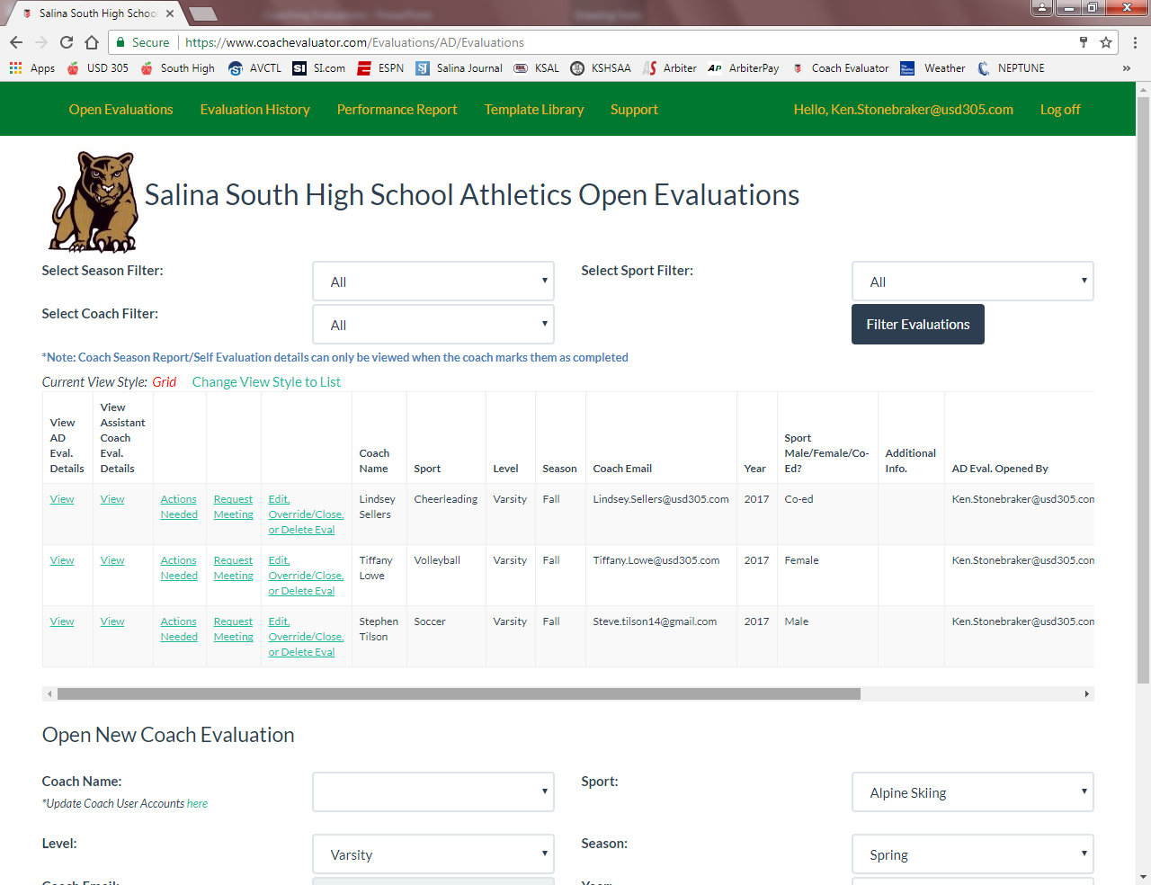
Open Evaluations

Slide 7
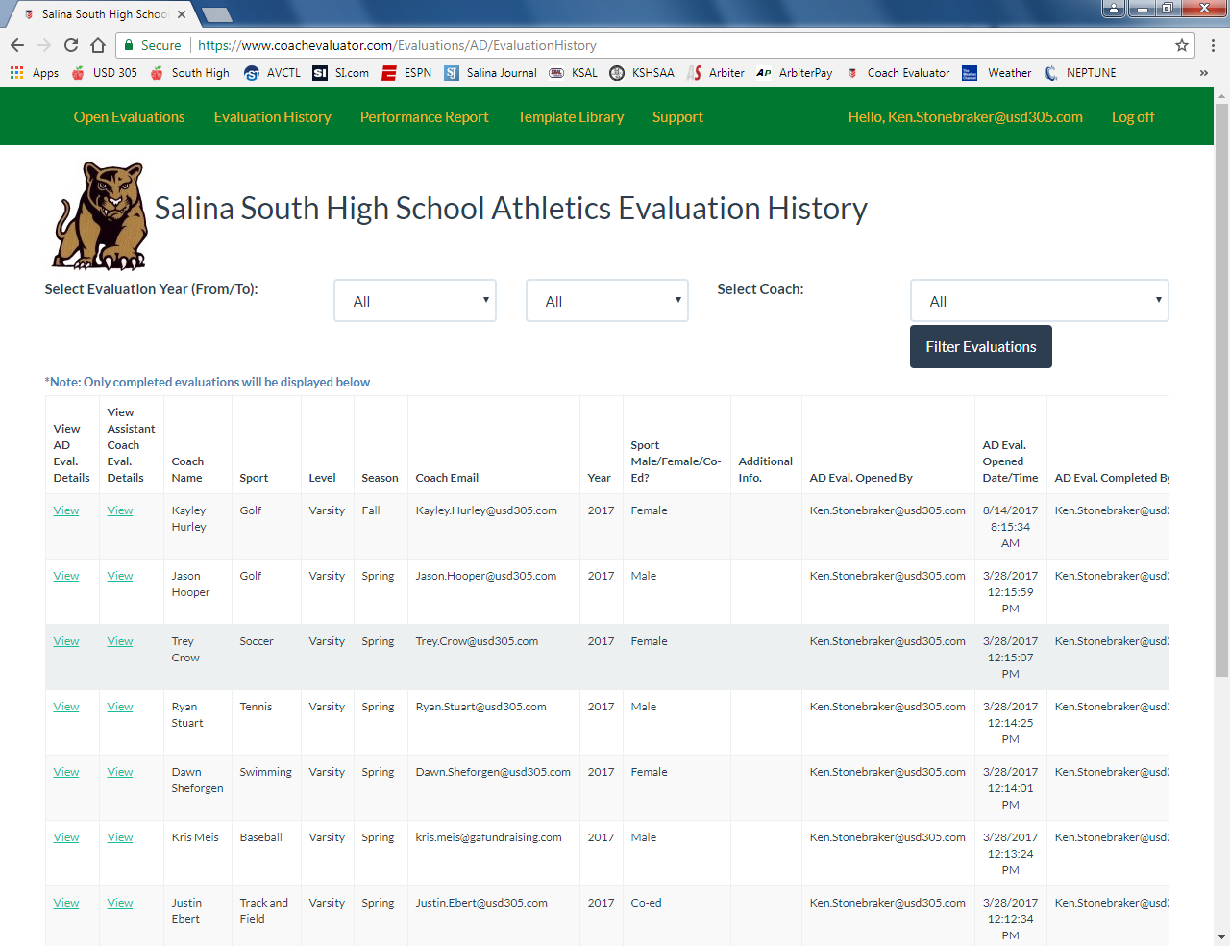
Evaluation History

Slide 8
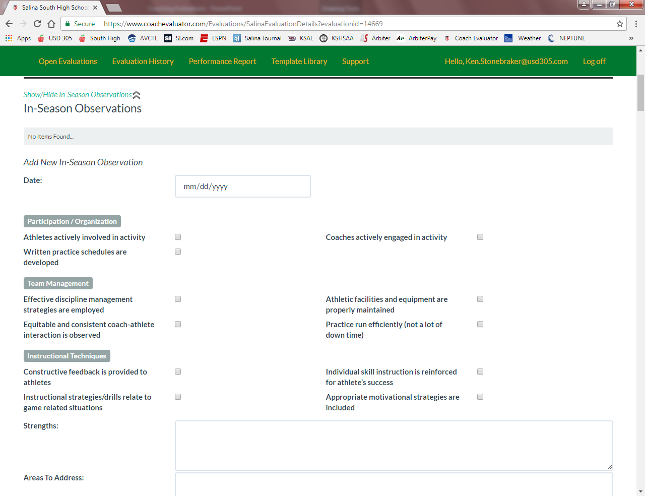
In-Season Observations

Slide 9
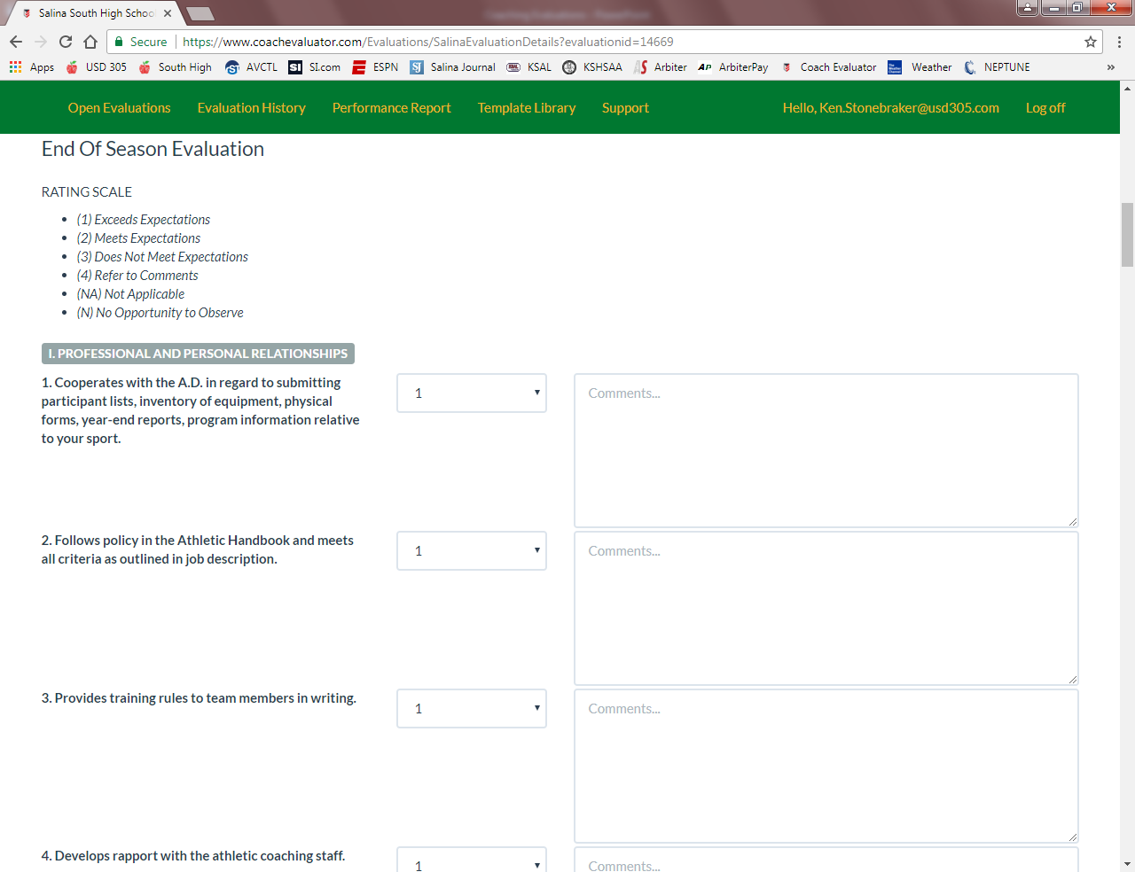
End of Season Evaluation

Slide 10
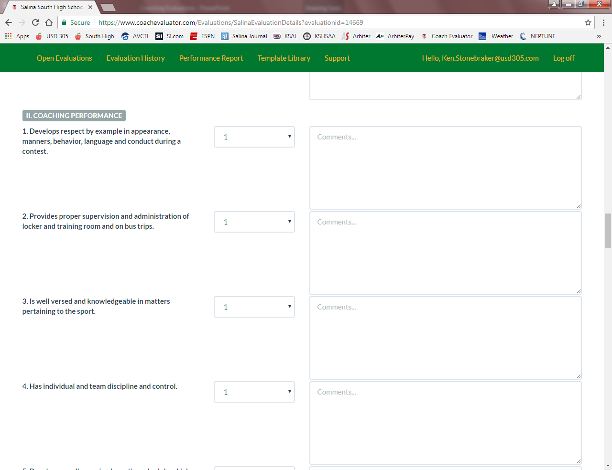
End of Season Evaluation

Slide 11
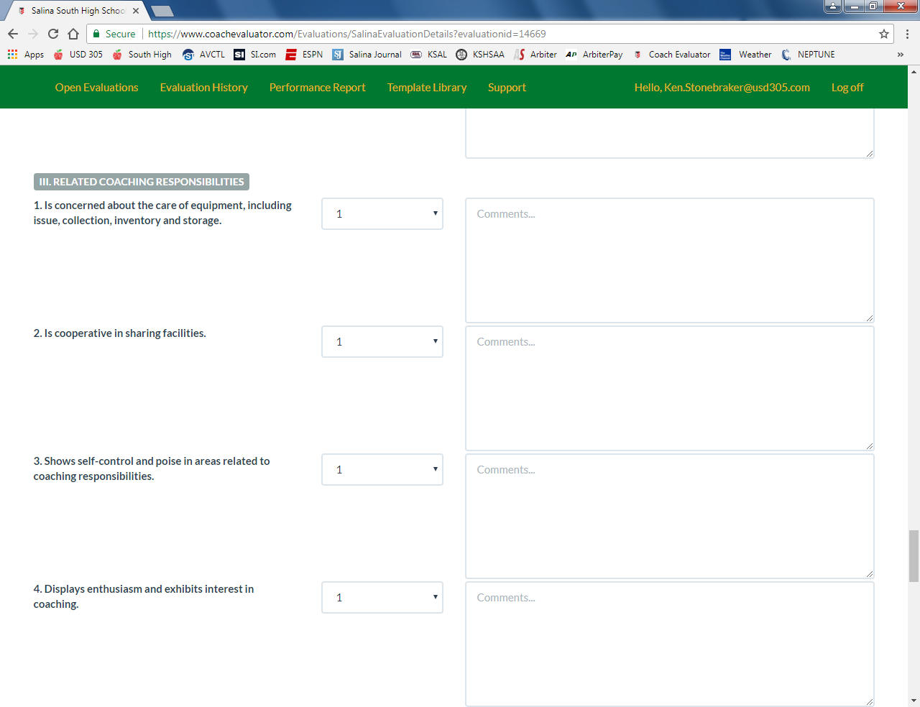
End of Season Evaluation

Slide 12
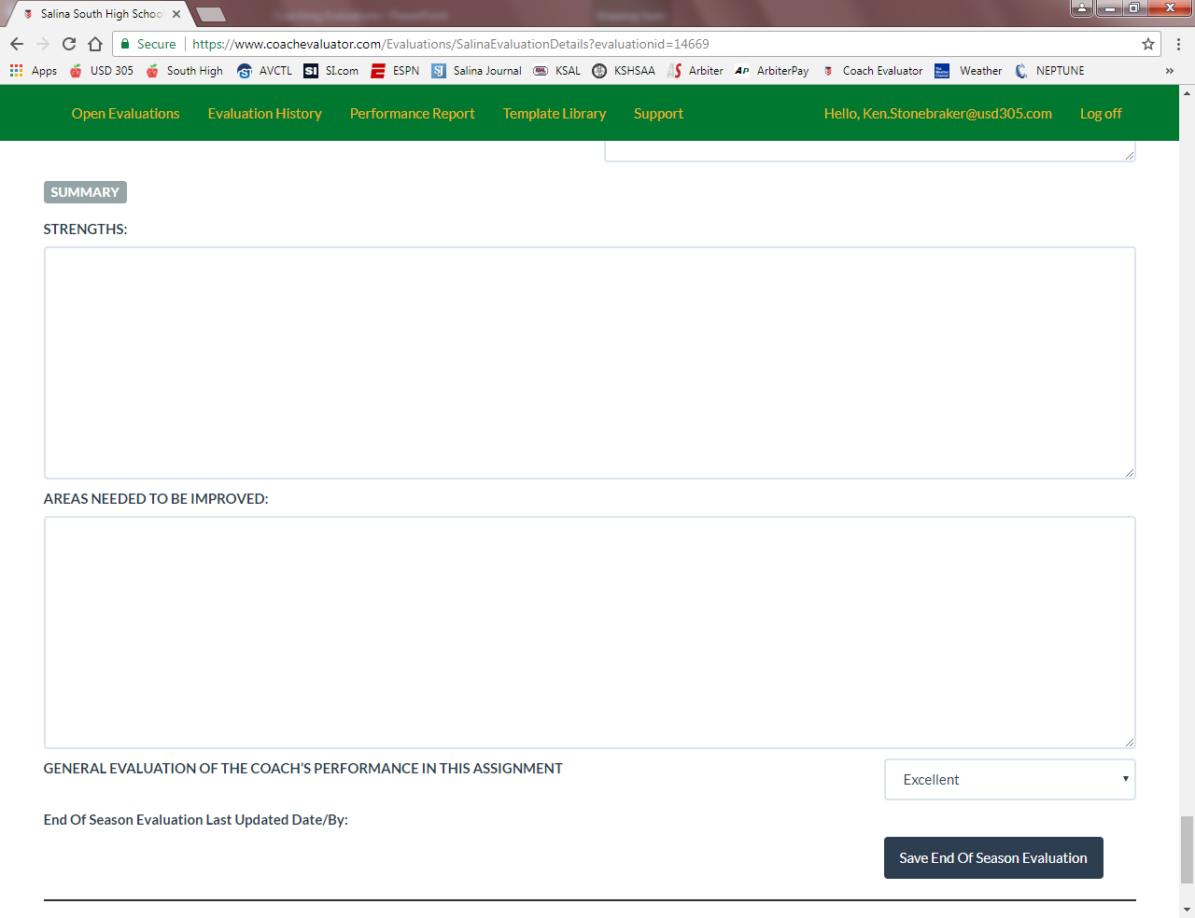
End of Season Evaluation

Slide 13
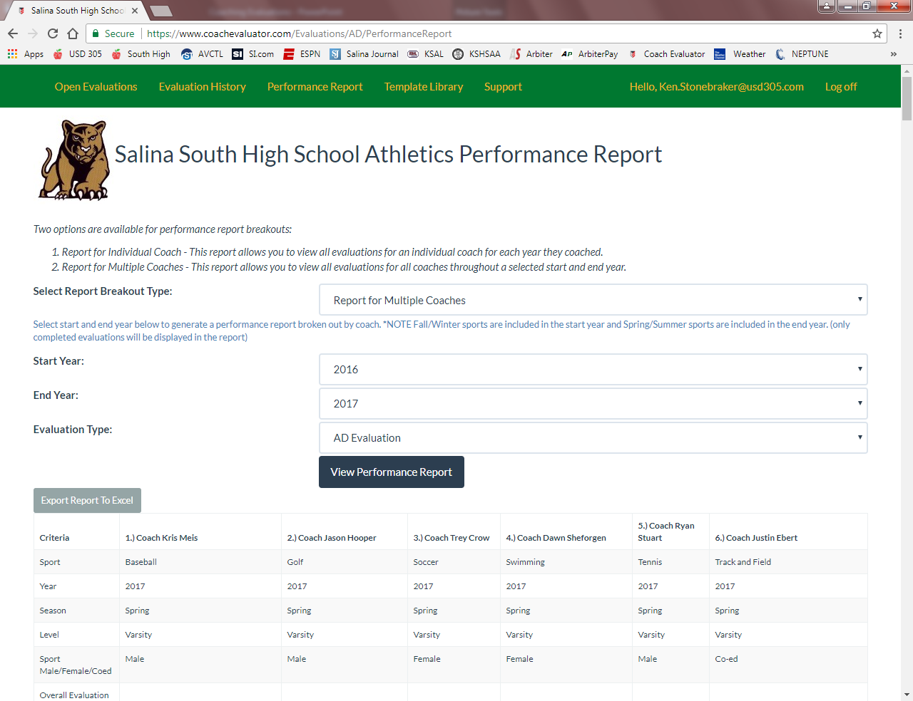
Performance Report

