Slide 1
EMERGENCY RESPONSE PREPERATION FOR A LARGE SCALE EVENT
RICH YELENICH, CAA
NORTH THURSTON PUBLIC SCHOOLS
LACEY, WA

Slide 2
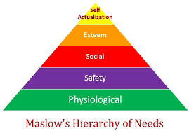
Schools do a great job providing for the needs of students and staff from 7 a.m. to 3 p.m.

Slide 3
We prepare for a wide variety of emergency events during the school day:
Lockdown
Shelter-in-place
Evacuations
Earthquake

Slide 4
WHAT ABOUT AFTER SCHOOL EVENTS?
VISITING STUDENTS/FANS
LARGE CROWDS
SUPPORT STAFF/OFFICIALS
NON-SCHOOL SPECTATORS
OFF-CAMPUS VENUES
WHAT KIND OF EMERGENCY RESPONSE PLANS DO WE HAVE IN PLACE FOR AFTER SCHOOL EVENTS?

Slide 5
Game Day Planning
Crowd Dynamics/Management
Emergency Action Planning
Routine Non-Game Day Operations
Technology/Information Management
Threat Assessment/Vulnerabilities Planning
Sport Facilities Design/Environment
Staff Performance/Training and Development
Security and Safety Aware Culture

Slide 6
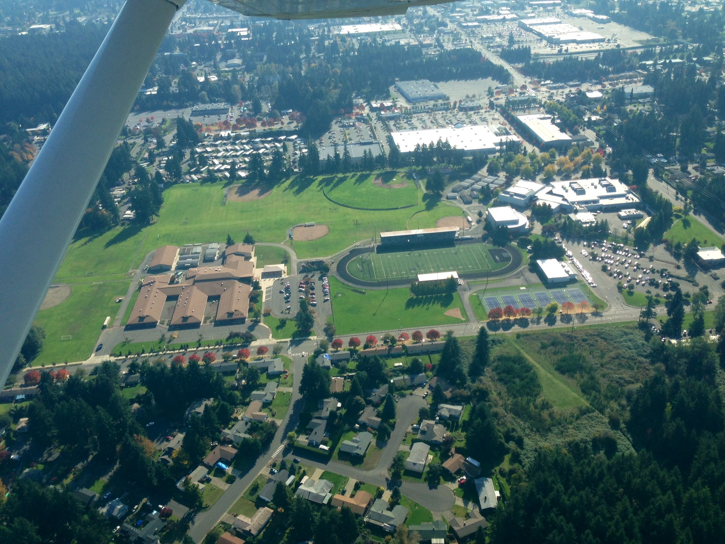
SOUTH SOUND STADIUM

Slide 7
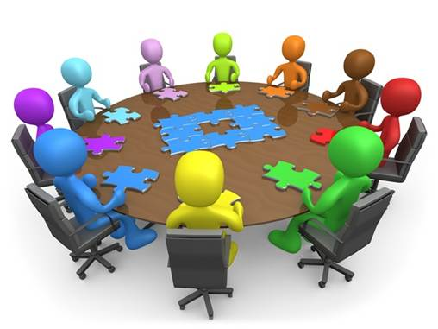
TABLE TOP ACTIVITY
Common best practice
Requires great support from district and community
Plan ahead—give yourself plenty of time (months, not weeks)
Seek out experienced people to assist you

Slide 8
Local connection
Experts
Prior work with schools
Experienced facilitator
Resources
Follow-up/After-Action Report

Slide 9
8-Step Exercise Design Process
Assess Needs
Define the Scope
Write a Purpose Statement
Define Objectives
Compose a Narrative
Write Major & Detailed Events
List Expected Actions
Prepare Messages

Slide 10
WHO TO INVITE?
Assistant Superintendent for Operations
Director of Facilities
Director of Communications
Custodial Supervisor
High School Administrators
High School Athletic Directors
Stadium Support Staff Leaders
School Resource Officers
Lacey Police Department
Lacey Fire Department
Thurston County Sheriffs Office
Lacey Emergency Management
Thurston County Emergency Management

Slide 11
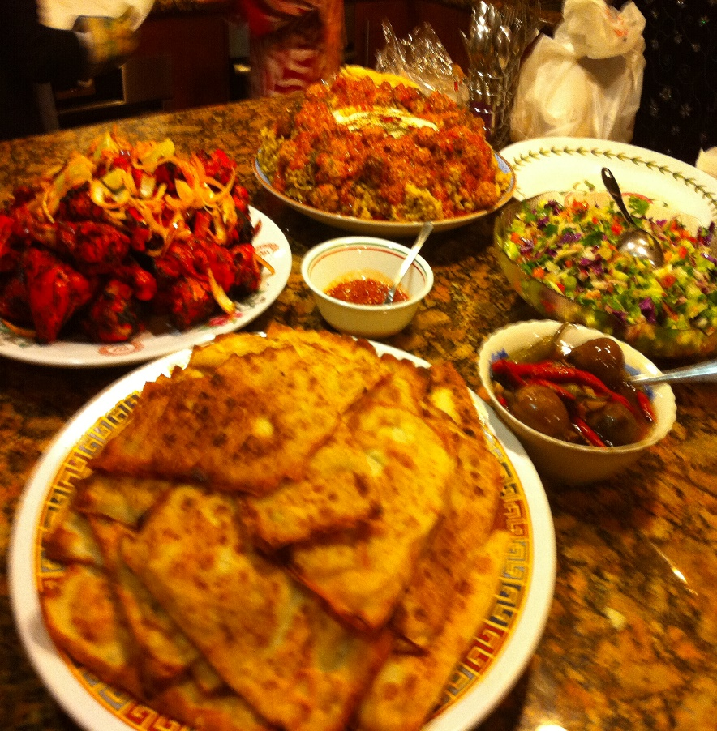
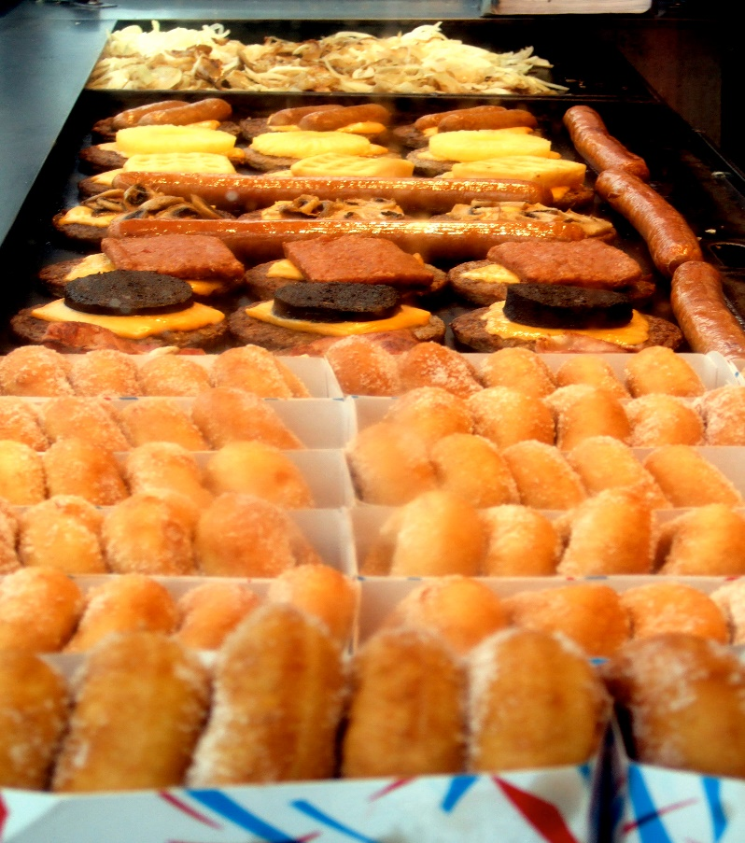
FEED THEM!!

Slide 12
DAY OF THE EXERCISE: WHAT WE WANTED TO ACHIEVE
COORDINATION OF A MULTI-AGENCY RESPONSE
EFFECTIVE SUPERVISION OF EVACUATION
ORDERLY MOVEMENT TO ASSEMBLY AREAS
COMMUNICATION TO THE PUBLIC
REUNIFICATION OF MINORS WITH PARENT/GURADIAN
TRAFFIC CONTROL PLAN

Slide 13
THINGS WE LEARNED
WHO’S IN CHARGE:
Law Enforcement (Violence/Threat)
Fire (Rescue)
Unified Incident Command (LE/Fire/School)
ROLES OF SCHOOL PERSONNEL:
Have it in writing—roles from admin to custodian to ticket takers
Train your people
Review
THINGS WE MUST CONSIDER:
Safe evacuation of handicapped/disabled
Reunification of unaccompanied children
Traffic flow—out and in
Communication responsibilities

Slide 14
CHANGES WE MADE
Specific emergency response training for all stadium staff
Supervision Bulletin for each game
Reunification plan
Improved signage at the stadium
Training of PA announcer
Use of social media in emergency communications
Improved communication between First Responders and school district personnel

